Slide 1

RISK AND RESILIENCE BOOTCAMP
1

Slide 2


Slide 3
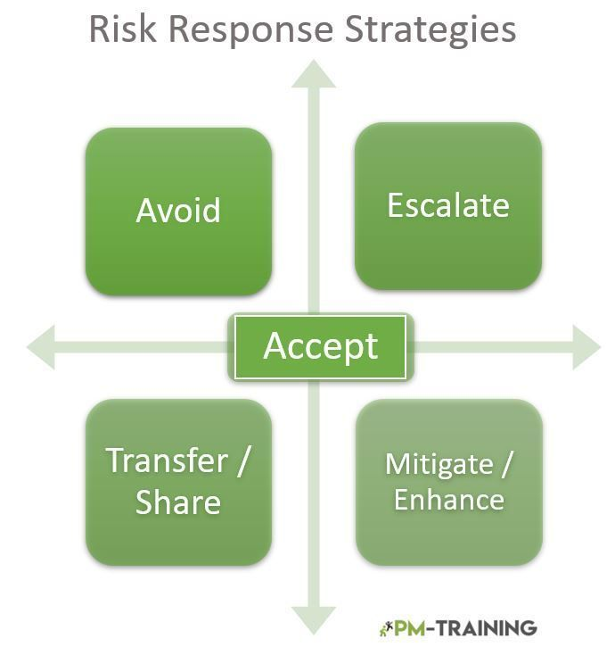
Risk Response Strategies
This module is an introduction to the standard risk response strategies
  Avoid
  Mitigate
  Transfer
  Accept

Slide 4
Risk Response Strategies
ISACA-aligned risk response strategies
  Represent how an organization chooses to treat a risk after it has been analyzed and prioritized
Avoid
  Eliminate the activity creating the risk
  Examples
    Shut down an insecure legacy application instead of repeatedly patching it
    Discontinue a feature that consistently creates compliance violations

Slide 5
Risk Response Strategies
Mitigate (reduce)
  Implement controls or redesign processes to reduce the likelihood or impact
  Examples
    Add MFA to reduce unauthorized access risk
    Strengthen monitoring and alerting for high-value transactions
Transfer
  Shift the financial or operational consequences to a third party
  Examples
    Cyber insurance
    Outsourcing to a cloud provider with contractual SLAs

Slide 6
Risk Response Strategies
Accept
  Acknowledge the risk and monitor it, but take no immediate action
  Appropriate when
    Risk falls within the organization’s risk appetite
    Cost of mitigation outweighs value
    The residual risk is low or unlikely
Decision considerations
  Alignment with risk appetite and tolerance
  Cost-benefit analysis of controls
  Impact to business objectives
  Time required to implement mitigation

Slide 7
Risk Response Strategies
Defines the organization’s deliberate posture toward prioritized risks
  After assessment of likelihood, impact, velocity, and systemic interdependencies
  These are aligned with standards like ISACA, COBIT, NIST RMF, and ISO 31000
  In mature risk programs response selection is not merely a control decision
  Instead, it is an integrated business decision incorporating governance mandates, financial constraints, regulatory expectations, and the organization’s risk culture
Effective response selection requires
  Rigorous evaluation of trade-offs between operational continuity, resilience, cost, regulatory exposure, and long-term strategic positioning
  Understanding that risks often interact, accumulate, and cascade
  This means responses must consider systemic rather than just isolated effects

Slide 8
Risk Avoidance
Seeks to eliminate the conditions that create exposure by discontinuing or altering the underlying activity
  Often most definitive response
  Also the most disruptive, because it might require material change to business operations or product strategy
Strategic justification
  High-impact or existential risks that exceed organizational tolerance
    For example: systemic fraud vulnerabilities in a business line
  Unbounded risk scenarios where uncertainty is too high to quantify
    For example: unknown security posture of unsupported third-party software
  Non-negotiable regulatory compliance gaps where remediation is impractical

Slide 9
Risk Avoidance
Considerations
  Opportunity cost analysis
    Avoidance may remove both risks and revenue streams
    Mature organizations evaluate net portfolio risk reduction versus foregone profit
    Avoiding the risk may be more costly than accepting it
  Legacy modernization decisions
    Decommissioning insecure legacy platforms may introduce transition risks and significant migration costs
    The impact of these two strategies has to be compared
  Long-term architectural strategy
    Avoidance supports strategic simplification initiatives
    Forces migration to a new less risky or less complex IT architecture
    Replacing the risky systems with a newer low risk variation

Slide 10
Risk Avoidance
Examples
  Terminating an entire data pipeline that handles sensitive information in a jurisdiction where new privacy laws make compliance infeasible
  Decommissioning custom cryptographic modules after regulatory assessments reveal unfixable design flaws

Slide 11
Risk Mitigation (Reduction)
Focuses on reducing either likelihood or impact, or both
  Through targeted controls, process engineering, and architectural redesign
  Risk reduction is the most common strategy due to its flexibility and ability to preserve business capabilities
When it is the optimal response
  Risks that can be reduced to within tolerance with feasible controls
  High-frequency operational risks where small improvements yield cumulative benefits
  Complex risks arising from human factors, process weaknesses, or inadequate monitoring

Slide 12
Risk Mitigation (Reduction)
Considerations
  Control effectiveness modeling
    Mature organizations evaluate mitigation using residual risk curves, control strength ratings, and compensating control structures
  Defence-in-depth composition
    Mitigation often involves layered controls (preventive + detective + corrective)
  Process resilience engineering
    Rather than placing controls on individual steps
    The entire process may be redesigned for resilience
    For example: eliminating manual hand offs
  Automation
    Automated containment and real-time remediation
    Can leverage machine learning and orchestration engines to reduce response time

Slide 13
Risk Transfer
Reallocates the financial, operational, or legal burden of the risk to another entity
  Often retaining partial oversight
  Transfer does not eliminate the underlying risk; it redistributes accountability
Effective when
  The risk is more efficiently managed by a specialized external provider
    For example: cloud hyperscalers
  Financial exposure can be shifted through insurance or indemnification
  Contractual relationships allow risk-sharing across partners

Slide 14
Risk Transfer
Considerations
  Shared responsibility models
    Cloud environments complicate transfer because control boundaries are distributed
    Misalignment in understanding these boundaries is itself a risk
  Risk capital optimization
    CFO and risk functions may analyze transfer through capital allocation models, optimizing insurance coverage against self-insurance
  Vendor concentration risk
    Excessive reliance on a single vendor introduces systemic exposure
    May outweigh the benefits of transfer
  Legal and regulatory transfer constraints
    Certain risks, like data protection obligations under GDPR, cannot be fully transferred even contractually

Slide 15
Risk Transfer
Examples
  Structuring a cyber liability insurance program with tiered deductibles and rider coverage for regulatory fines, breach response, and forensic costs
  Outsourcing cryptographic key management to a certified HSM provider with validated compliance frameworks
  Entering a co-managed security operations center arrangement where operational risk is shared, but governance and oversight remain internal

Slide 16
Risk Acceptance
Acknowledges that the organization intentionally retains the risk
  Often with a plan for heightened monitoring or periodic reassessment
  Mature acceptance is not passive
  It is a deliberate business decision supported by evidence and aligned with risk appetite
Acceptance rationale
  Residual risk after mitigation falls within tolerated levels
  The risk is intrinsic to strategic innovation
    For example: new markets, emerging technology adoption
  Controls are too costly relative to the expected loss
  Risk is low-likelihood, low-impact, or both, and adequately monitored

Slide 17
Risk Acceptance
Considerations
  Documented governance sign-off
    Acceptance typically requires senior management or risk committee approval and periodic review
  Conditional acceptance
    Accepted risks may convert to “trigger-based responses” if KRIs exceed thresholds
  Portfolio balancing
    Risk acceptance in one area may require enhanced mitigation elsewhere to maintain overall risk equilibrium
  Shadow risks
    Organizations must guard against the accumulation of “accepted but unmonitored” risks

Slide 18
Risk Acceptance
Examples
  Accepting the residual risk of using a near-end-of-life system temporarily
    Acceptable during a multi-year transformation program
    But with compensating detective controls.
  During the adoption of Infrastructure-as-Code
    Accepting the risk of increased operational incidents
    Balanced against the benefit of improving long-term agility and reducing configuration drift

Slide 19
Selecting the Optimal Strategy
Risk response selection is guided by structured decision tools
  Alignment with risk appetite and tolerance
    Appetite statements translate strategic objectives into measurable tolerances
    For example: maximum accepted downtime per quarter
    Responses must align with these thresholds while balancing innovation and safety
  Cost-benefit and value realization analysis
    Includes direct control costs
    Long-term operational simplification
    Resilience improvements
    Avoided losses.
    The goal is not minimizing risk, but maximizing value relative to risk exposure

Slide 20
Selecting the Optimal Strategy
  Impact on business capabilities and strategic planning
    Decisions must consider architectural implications, future scalability, and interdependencies
    A mitigation that stifles innovation may be more harmful than accepting the risk
  Implementation time, complexity, and risk velocity
    High-velocity threats like zero-day exploitation may require temporary acceptance with compensating controls until mitigation is feasible
    Slow-moving risks like technical debt accumulation may justify longer-term mitigation programs
  Regulatory and compliance constraints
    Some risks cannot be accepted due to legal obligations
    Transfer mechanisms may be insufficient to satisfy regulatory requirements
  Systemic and cascading impact evaluations
    Response strategies must account for second-order effects across interconnected systems
    Example: Avoiding a vulnerable service may unintentionally increase load on another system, raising new risks.

Slide 21

Q&A and open discussion
Notes:
Now is the time to engage in an interactive Q&A session where you can ask questions, share insights, and clarify any doubts about the topics we have covered so far.
This open discussion is designed to ensure that every participant has the opportunity to voice their thoughts and learn from the collective experience of the group.
Your questions and comments are valuable as they help us identify areas that may need further explanation and enable us to tailor future sessions to your needs.
We encourage you to speak up and contribute to the dialogue, as this interaction is one of the key components of our interactive learning approach.
As the session progresses, take note of any questions or ideas that you would like to revisit, and feel free to share your perspectives with the class.

